Slide 1
PROGRAMMATIC Assessment IN THE College of Pharmacy
DONALD BLUMENTHAL, PHD
ASSOCIATE DEAN FOR INTERPROFESSIONAL EDUCATION

Slide 2
BRIEF HISTORY OF ASSESSMENT IN THE COLLEGE OF PHARMACY
2003: Ad hoc COP assessment committee formed
2004: Standing COP Assessment Committee established
2006: Accreditation site visit team acknowledges “culture of assessment”
2011: COP Dean creates the position of Assistant Dean of Assessment
2018: COP hires 0.5 FTE staff for assessment

Slide 3
ASSESSMENT COMMITTEE COMPOSITION: FACULTY, STUDENTS, ALUMNI, DEANS
Jennifer Babin – Chair
Don Blumenthal
Tom Cheatham
Hamid Ghandehari*
Lauren Heath
Patricia Orlando*
Heeseung Hong+ (P1)
Lydia McKay+ (P4)
Chloe Munroe+ (P1)
Adelaide Tempest+ (P2)
Staff: Craig Henchey
Ex officio: Herron & Moorman
Student +
Alumni *

Slide 4
Schedule of surveys: 2017-2022
 | Student Year End Survey (P4s) | Faculty Survey | Alumni Survey | Preceptor Survey | Employer Survey | Admission Post-Interview (Applicants) | CAPE Outcomes Mapping (Course Directors) | Stress and Satisfaction (for Munger)
2022 | April
2021 | April |  | ? |  | ? | May
2020 | April AAMS | April AAMS | June AAMS | May AAMS | ? | May
2019 | April | May |  |  |  | May(did not occur) | Revised classes in April | March
2018 | April |  |  |  |  | June | P1-P3 | March
2017 | April | Dec. | Sept. |  | X | March | P1s and P2s | March

Slide 5
Flow of Assessment Data

Slide 6
Course Level Curricular Mapping: CAPE Educational Outcomes

Slide 7
Four Years of P4 Student Self-assessment of competency based on CAPE Educational Outcomes (2019 data reflect new PharmD curriculum)

Slide 8
Progression in student self-assessment of competencies: CapeEducational Outcomes

Slide 9
External Assessments Of the Curriculum
Pharmacy Curriculum Outcomes Assessment (PCOA)
National Association of Boards of Pharmacy
Administered in Spring Semester (April) to P2 and P3 students
All P3 students from US Schools/Colleges of Pharmacy are required to take the exam
Reports are provided to each college showing how their students perform relative to reference group (>19,000 students)

Slide 10
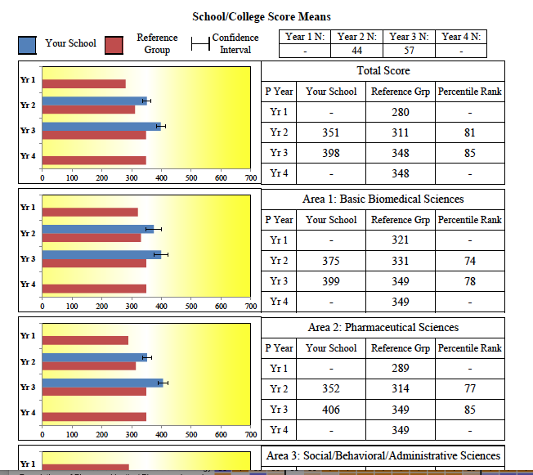
Screen shot of 2019 PCOA Data

Slide 11
Summary
Assessment should be a team sport involving everyone in the organization
Whenever possible try to collect data from all stakeholders and from external sources
Distribute data widely, with recommendations for improvements
Conduct longitudinal assessments to monitor the effects of changes
Periodically review and update survey instruments and discard outdated or poor questions

