Slide 1
Atmospheric Sciences
On the Journey to Assessing Learning Outcomes
John Horel, Chair, john.horel@utah.edu

Slide 2
How Did We Get Here?
2008: Increased financial pressures on Department
2008-2009: holistic examination of curriculum
2010: Curriculum revisions implemented:
changing from a rigid course progression for majors to distinct even and odd year sequences
shifting the emphasis from required courses to elective courses for majors
offering many required and elective courses only every other year and reducing prerequisites
offering some required and elective classes as half semester short courses for undergraduates only
having undergraduate students enroll in the first half semester of a course that continues for graduate students for the entire semester

Slide 3
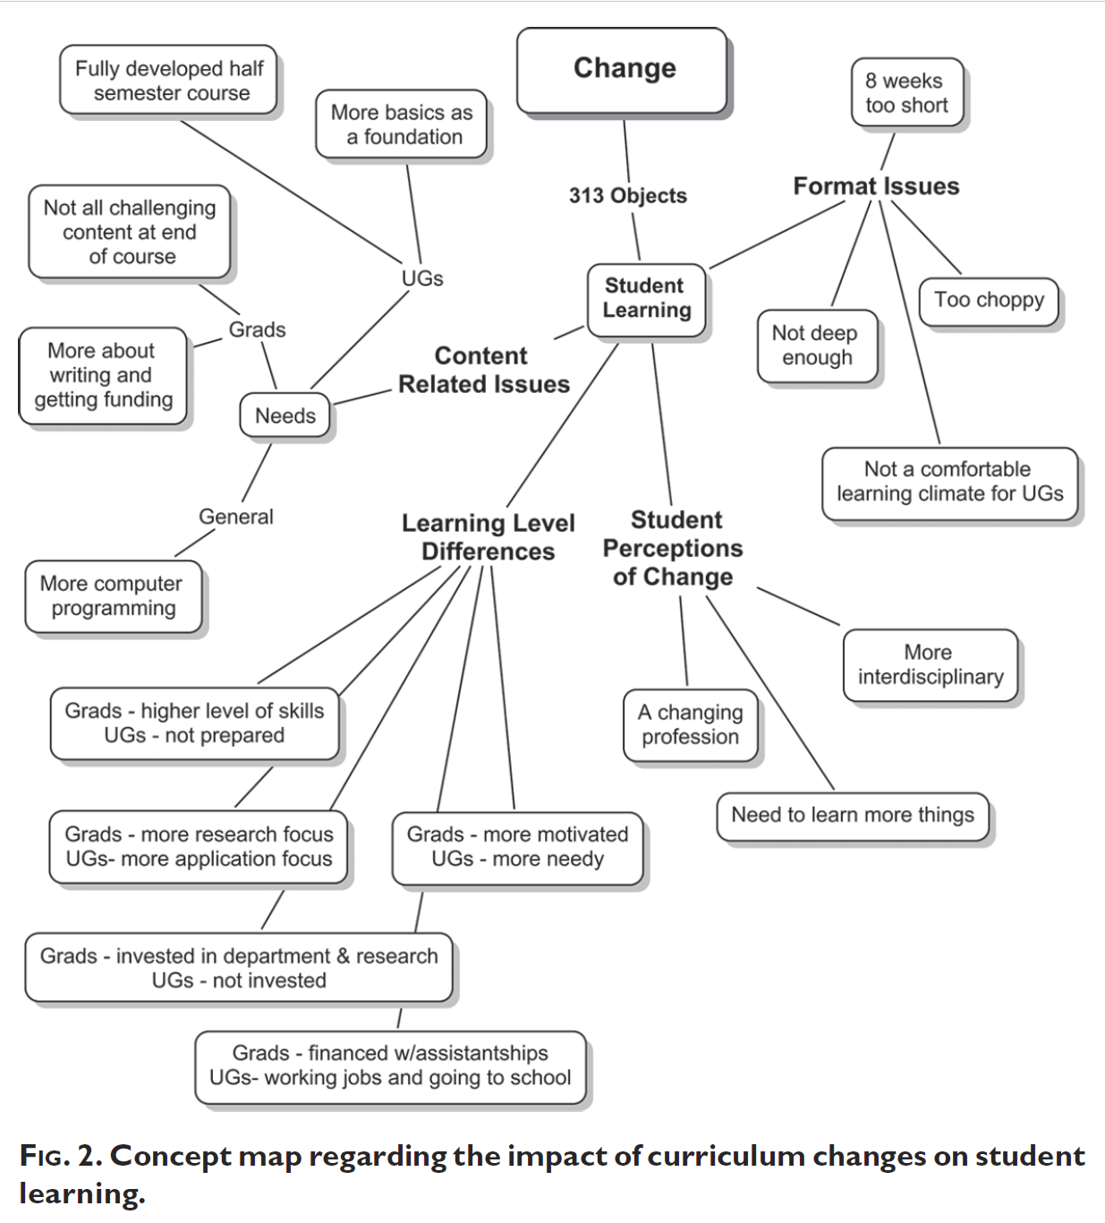
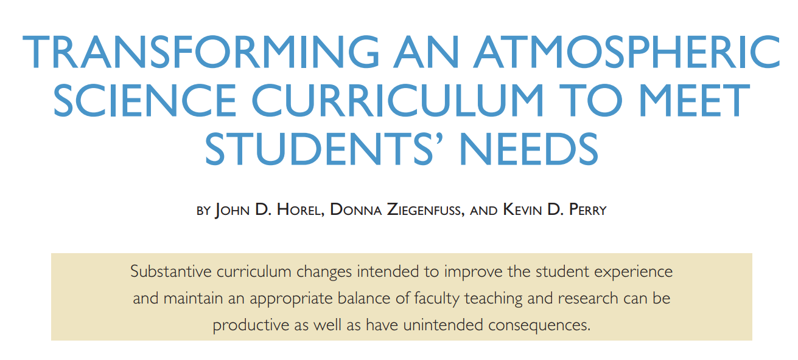
Did Those Changes Make A Difference?
Benefits to stabilize funding, teaching loads, course offerings
Concerns of students & faculty at the outset have continued
Need to reevaluate and implement changes
Bulletin of the American Meteorological Society
http://dx.doi.org/10.1175/BAMS-D-12-00115.1

Slide 4
2017-2018: First Steps
The department curriculum committee began work to review and make recommendations regarding the undergraduate curriculum
Major restructuring of the curriculum recommended to better meet the needs of our students
Town Hall in September 2018 provided feedback from students, faculty, staff on curriculum, including:
Undergrads: would like to see “tracks” (e.g., atmospheric scientist, environmental scientist) so they have an idea of what to take depending on career interests
Grad students: graduate electives are burdensome with exceptional demands on their time
Faculty: Not much momentum for online classes at this time, although the general feeling was that if we do one, it should be in an area we can do something unique, such as mountain weather or air quality

Slide 5
2018-2021: Timeline
Fall 2018: Syllabi requested for all existing and future courses from faculty
Each syllabus needed to include Course Outcomes & Evaluation Methods
2018-2019: Monthly discussions with faculty ongoing
Fall 2019: Goal to introduce and discuss changes with students deferred to Fall
Fall 2020: Implement revised curriculum
AY 2020-21: Have in place more comprehensive Assessment for individual courses and Program overall

Slide 6
Department Review
7-Year Department Review in final stage
Recommendations from the Department Review:
1) establish clear, measurable expected outcomes of student learning
2) ensure that students have sufficient opportunities to achieve those outcomes
3) systematically gather, analyze, and interpret both direct and indirect evidence to determine how well student learning matches our expectations
4) use the resulting information to understand and improve student learning

Slide 7
Peer Institutions
Fall 2018: Heads and Chairs Meeting of the American Meteorological Society/American Geophysical Union
Defining learning outcomes for courses mandatory at nearly all institutions
Concerns regarding the applicability of the ABET level of assessment
Assessment approaches used by most institutions
Exit surveys common
Mapping of courses to outcomes increasingly expected
Quantifying evaluation of learning outcomes at the course level remain rare
Exit exams very rare

Slide 8
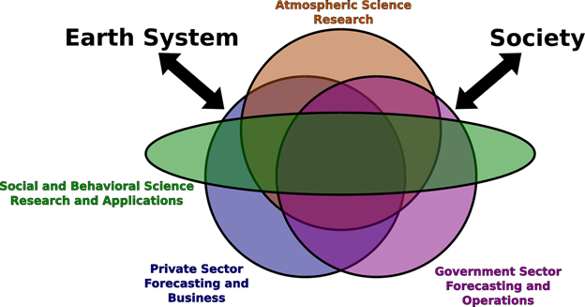
American Meteorological Society Guidelines:
Raising Awareness of Diverse Opportunities in the Field

Slide 9
Back to the Future: Draft Tracks
Professional Meteorologist. This option is intended for students interested in applying knowledge of the atmosphere in diverse careers, for example, weather forecasting, mountain weather and climate, analysis and interpretation of geophysical data, or broadcasting. This option satisfies the requirements of the federal government for employment as a meteorologist with the National Weather Service and what is expected by many other agencies and private firms relying on weather and climate information.
Environmental Scientist. This option is intended for students interested in applying knowledge of the atmosphere to diverse interdisciplinary applications, for example, hydrology and snow science; climate system science, air chemistry including health impacts of air pollution, or public policy.

Slide 10
B.S. Learning Outcomes Being Updated
Consistent with guidelines of the American Meteorological Society
Students who graduate with a BS in Atmospheric Sciences should develop the critical thinking, problem solving, reasoning, analytical, and communication skills that will provide them with the necessary versatility for long-term success as science professionals
Specific expected learning outcomes are:
Demonstrate understanding of core concepts in the atmospheric sciences involving fluid dynamics, thermodynamics, radiative transfer, and air chemistry
Demonstrate how basic understanding of the atmosphere can be applied to diverse interdisciplinary applications
Apply measurement principles, numerical and statistical analysis methods, and a high-level structured programming language to investigate atmospheric processes and environmental problems
Possess the ability to communicate in both written and oral forms with peer and lay audiences using scientific evidence
Apply basic and applied knowledge through completion of a capstone education, research, or work experience
Demonstrate understanding of professional and ethical responsibilities expected of scientists
Be prepared for higher-level education or to embark on a career with skills adaptable to evolving opportunities in the workforce

Slide 11
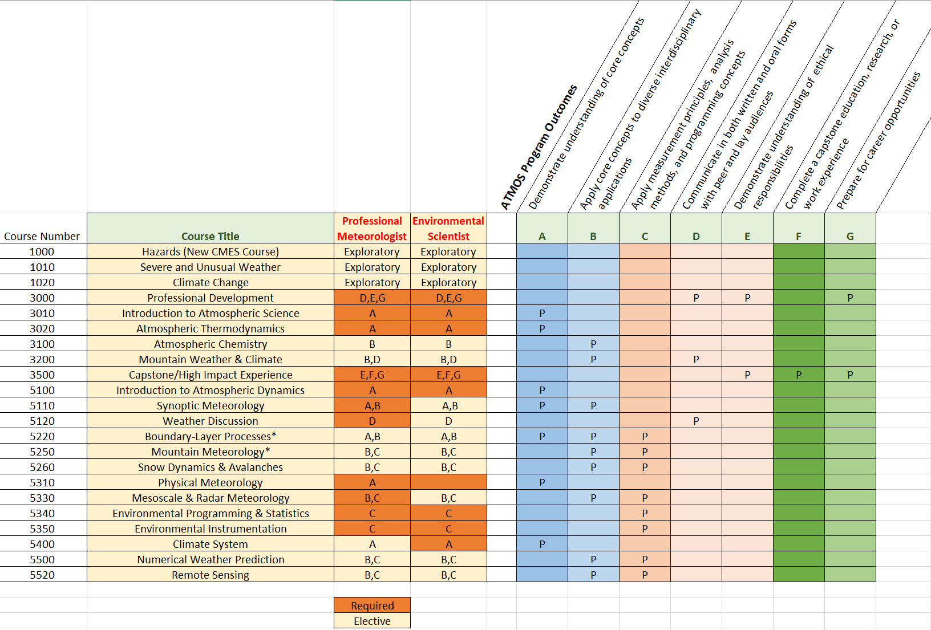
Draft Direct-Assessment Outcomes Matrix

Slide 12
Updating Our Undergraduate Online Exit Survey
Please rate whether our Department has helped you meet the following Learning Outcomes:
Demonstrate understanding of core concepts in the atmospheric sciences involving fluid dynamics, thermodynamics, radiative transfer, and air chemistry
…
 | Poor | Fair | Good | Very Good | Excellent | N/A
Core concepts

Slide 13
Questions?
john.horel@utah.edu

Slide 14
Assessment: Undergraduate Exit Survey
21-question survey with 18 responses out of 22 total BS graduates from 2016-17
How many hours per week did you work in a job while pursuing your degree?
How much debt did you accrue while being a student in Atmospheric Sciences?

Slide 15
Program Purpose
B.S.
To prepare graduates to pursue careers within atmospheric science or other environmental fields while providing a foundation upon which additional education, training, or specialization in science, policy, education, law, or other fields may be pursued.
M.S.
To prepare students for doctoral research or careers in the atmospheric sciences or other environmental fields that require an advanced education and technical skills or the ability to conduct research typically directed by a senior scientist.
Ph.D.
To prepare students for careers in the atmospheric and related sciences which require the ability to conduct original research and/or advanced technical analysis and reasoning skills.

